Slide 1
operating systems
OS basics

Slide 2
Operating systems

Slide 3
Electronics: Modern Computers
Computer system (PC/desktop/workstation) components:
CPU (one or more processors)
Main memory (usually SDRAM)
Primary storage (usually HDD/SSD)
Secondary storage (CD-ROM/DVD-ROM/Zip Drive/USB stick/…)
Publishing (printer, scanner, …)
Interactive I/O devices (keyboard, mouse, joystick, monitor, …)
Multimedia devices (speakers, mic, cameras)
All these devices need to be managed
Done by a layer of software running on the PC
Called ‘operating system’ (hereinafter OS)

Slide 4
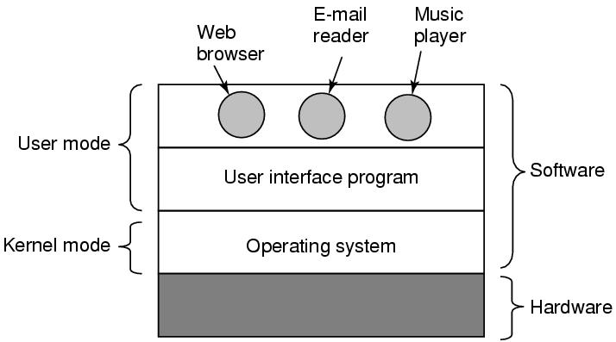
Computing: System Layers and the OS
OS is a (mega) software program
Runs on ‘hardware’
Intermediary / interface between ‘user’ and ‘hardware’
‘User’ programs run on top of the OS

Slide 5
OS: Goals and functions
Make the computer hardware easy to use
Boot up, set up system resources
Present methods for easy interaction
Ease the solving of user problems
Control and execute ‘user’ / ‘application’ programs
Use the computer hardware in an efficient manner
Multi-tasking
Multi-user

Slide 6
Computer interaction: Human roles
Levels of human interaction with computers
End
User
Application programmer
Applications
Utilities
Systems programmer
Operating System
Computer Hardware

Slide 7
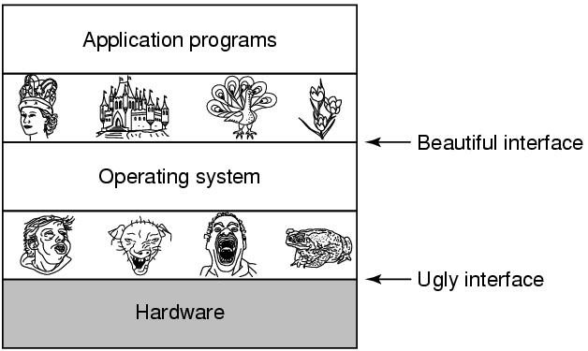
OS: Layered system abstraction
The OS abstracts the underlying hardware
Presents a ‘simpler’, ‘nicer’, ‘more lucid’ view upwards

Slide 8
Os - services, components

Slide 9
OS: Services – General
Various services provided by an OS:
System boot-up and access
Device initialization, handling
‘Drivers’ for various devices – disks, network, CDROMs, etc.
I/O and files
Handling I/O between various devices
Handling disks, file-systems, etc.
Program execution
Loading and running executable in memory, handling exits / exceptions
System management
Resource ownership and management
Managing access credentials (user-logins, etc.)

Slide 10
OS: Services – Program development
Services for program development:
IDE type 1: Windows IDE
Visual Studio components
Solution/Project, Code editor, Compiler, Linker, Runner, Debugger
Create a Windows ‘exe’
IDE type 2: Embedded IDE
IDE components
Project, Code editor, Cross-compiler, Linker
Create an ‘exe’ for the Embedded controller (eg. PIC, ARM, …)
Programmers and/or debuggers
Simulators
HIL (hardware-in-the-loop) programmers and/or emulators
JTAG ICE, etc.
IDE type 3: Kernel IDE (OS programming)
IDE components
Kernel development tools (for Linux – GNU)
Code editor, Compiler, Linker, Kernel debugger (K-GDB, …)

Slide 11
OS: Components
A mega software bundle, comprising:
‘Kernel’
Program/process running at all times on the computer
Could also contain Scheduler
Decides time and space priority of execution of various tasks
System programs
File-system stacks, Network stacks, UI components, Shells, etc.
Application programs
Browsers, Email clients, Word processors, Office suites, IDEs, etc.
User-created programs
‘exes’ created by programmers, Web programs, etc.

Slide 12
Os views and viewpoints

Slide 13
OS: Views and viewpoints
3 classical views
As a resource manager
Manages and allocates system resources
As a master control program
Controls the execution of user programs and operations of I/O devices
As a command executer
Provides an environment for running user commands
Modern view (new, since the advent of Cloud)
As a virtual machine
Abstracts underlying hardware

Slide 14
OS: Resource manager view
As a resource manager, the OS:
Manages system resources
CPU, Memory, Communication channels, Time
Tasks, Processes, Threads, Applications, Users
Handles allocation of resources
To concurrent users and/or programs
In time and/or space
Handles conflict resolution, resource contention
Aims for efficient and ‘fair’ use
Maximize throughput
Minimize response time
Bottom up view

Slide 15
OS: Control program view
As a master control program, the OS:
Manages all the components of a system
In an integrated manner
Controls the execution of user programs and I/O devices
To prevent errors and improper usage of these resources
Implements a supervisory security model
Handles protection of resources and data
Black box view

Slide 16
OS: Command executer view
As a command executer, the OS:
Acts as an interface
Between the users and the machine hardware
Supplies services and/or utilities to users
Web servers, File servers, …
Provides users with convenient interfaces for system usage
Text mode command shells (CLIs)
Graphical mode interfaces (GUIs)
Top down view

Slide 17
OS: Virtual machine view
In this view, the OS is:
A collection of software enhancements
Executed on bare-metal hardware
Culminating in a high-level ‘virtual machine’
That serves as an advanced programming environment
The OS acts as an interface
Between the users and hardware
That ‘hides away’ the details of the hardware
The OS constructs higher level (virtual) resources
Out of lower level (physical) resources
Hardware, files, network ports, etc.

Slide 18
OS: Role in Computing
OS plays a central role in
Enhancing user interaction with computer hardware
Graphical user interfaces, etc.
Efficient utilization of expensive hardware resources
Servers, Cloud, Virtualization frameworks, …
⇒ OS is the most complex piece of software ever written!
Combines concepts from multiple areas
Computer Science
Algorithms, Data structures, Graph theory, Automata theory
Mathematics
Number theory, Information theory
Computer Engineering
Computer architecture, Programming languages

Slide 19
OS: Software complexity
Software complexity is measured in:
Lines of code (LOC)
Units:
Example OS LOCs:
KLOC | Kilo (thousands) of LOC
MLOC | Mega (millions) of LOC
GLOC | Giga LOC
OS | Year of release | MLOC
MS-DOS | 1981+ | ?
Windows XP | 2001 | 45
macOS X 10.4 | 2005 | 86
Windows 7 | 2009 | 55
Linux (kernel ~v4) | 2015 | 20.2
Ubuntu/Debian | 2012 | 420

Slide 20
OS: Why study it?
An insight into how the OS works
Enables programmers appreciate system issues better
Streamlines application-side resource usage
As
Device and interface numbers multiply
Tasks and their interactions get more involved
Software intricacy increases
Data security and privacy demands keep rising
System complexity goes through an upsurge
Programming to make things work becomes harder
Some knowledge of OS internals
Goes a long way in designing better systems

Slide 21
OS basics summary
What is an OS?
OS goals and functions
OS components
OS services and service types
OS viewpoints

Slide 22
Thank you!

